Slide 1

Business Process Automation
with Power Automate and Copilot Studio Agents
WSQ Course Code: TGS-2022017524 · 2-Day Hands-On Training · Modules 1–5
Conducted by Tertiary Infotech Academy Pte Ltd · UEN 201200696W
Version 7.4 (7 Aug 2026) · www.tertiarycourses.com.sg · https://lms-tms.tertiaryinfotech.com/
Business Process Automation with Power Automate & Copilot Studio Agents · TGS-2022017524 · © 2026 Tertiary Infotech Academy Pte Ltd
1

Slide 2
TRAQOM · SSG DIGITAL ATTENDANCE
Digital Attendance (Mandatory)
• It is mandatory to take the AM, PM and Assessment digital attendance for WSQ-funded courses.
• The trainer/administrator displays the digital attendance QR code from the SSG portal.
• Scan the QR code with your mobile phone camera and submit your attendance.
• A minimum of 75% attendance is required to be eligible for assessment and funding.
Business Process Automation with Power Automate & Copilot Studio Agents · TGS-2022017524 · © 2026 Tertiary Infotech Academy Pte Ltd
2

Slide 3
YOUR TRAINER · GENERAL
About the Trainer
NAME
____________________________________________
?
TITLE / DESIGNATION
____________________________________________
QUALIFICATIONS
____________________________________________
Your Trainer
AREAS OF EXPERTISE
____________________________________________
General Trainer template — to be completed by the trainer
TRAINING & INDUSTRY EXPERIENCE
____________________________________________
CONTACT
____________________________________________
Business Process Automation with Power Automate & Copilot Studio Agents · TGS-2022017524 · © 2026 Tertiary Infotech Academy Pte Ltd
3

Slide 4
YOUR TRAINER
About the Trainer
ROLE
Principal Trainer, Tertiary Infotech Academy Pte. Ltd.
AA
CERTIFICATION
Microsoft Power Platform, AI and data analytics — 20+ years of training experience.
Dr. Alfred Ang
DELIVERS
WSQ courses on AI, business automation, data science and software engineering.
Principal Trainer Tertiary Infotech Academy Pte. Ltd.
FOUNDER
Founder and lead instructor at Tertiary Infotech / Tertiary Courses.
Business Process Automation with Power Automate & Copilot Studio Agents · TGS-2022017524 · © 2026 Tertiary Infotech Academy Pte Ltd
4

Slide 5
ICE-BREAKER
Let's Know Each Other
• Your name and organisation / role.
• Your experience with Power Automate, Copilot Studio or other automation tools (if any).
• One repetitive business process you would love to automate after this course.
Business Process Automation with Power Automate & Copilot Studio Agents · TGS-2022017524 · © 2026 Tertiary Infotech Academy Pte Ltd
5

Slide 6
HOUSEKEEPING
Ground Rules
Set your mobile phone to silent mode.
Participate actively — no question is too small.
1
2
Mutual respect: agree to disagree.
One conversation at a time.
3
4
Be punctual; return from breaks on time.
75% attendance is required.
5
6
Business Process Automation with Power Automate & Copilot Studio Agents · TGS-2022017524 · © 2026 Tertiary Infotech Academy Pte Ltd
6

Slide 7
COURSE OUTCOMES
What You'll Learn
add AI
expose it
make it true
Automate
the workflow
Build
the agent
Connect it
over HTTP
Ground it
with RAG
1
Design
2
Build
3
Govern
Read a business process and decide which parts must be deterministic and which may be AI.
Create Power Automate flows and Copilot Studio agents with tools, skills and knowledge.
Place a human where the consequence lands, and test what the agent must refuse.
By the end you can build the automation, add the agent, and defend where you put the human.
Business Process Automation with Power Automate & Copilot Studio Agents · TGS-2022017524 · © 2026 Tertiary Infotech Academy Pte Ltd
7

Slide 8
THE JOURNEY
Thirteen Connected Labs
0
Environment Setup
5b
Calling Workflow from Agent
Developer environment, Dataverse, credits
The agent runs the flow as its tool
1
Trigger and Actions
6
HTTP + Approval Agent
Form → email; dynamic content
Structured output; the AI never writes the record
2
Log to Excel
7
HTTP + Chatbot
Commit the audit row before confirming
The agent alone, in public
3
Leave Application Approval
8
HTTP + Human Review
The flow pauses for a manager
The run that will not proceed
4
Agents
9
RAG with Knowledge Base
Instructions · skills · knowledge · tools
Three nodes, no ingestion
4b
Multi-Agent Content Team
10
RAG with Pinecone
Research → draft → review → human approval
Chunking, embeddings, top_k
5
Calling Agent from Workflow
Topic in, M365 Copilot blog, posted to Teams
Thirteen labs, each reusing the one before it. Nothing is rebuilt from scratch.
Business Process Automation with Power Automate & Copilot Studio Agents · TGS-2022017524 · © 2026 Tertiary Infotech Academy Pte Ltd
8

Slide 9
LEARNING APPROACH
How This Course Works
1
Concept
2
Pattern
3
Lab
4
Probe
5
Reuse
The idea and the decision rule, before the product is opened.
The same idea drawn as a business workflow you could hand to a colleague.
You build it, in the numbered lab named on the concept slide.
You try to break it — the refusals and wrong answers are the lesson.
The working artefact becomes the starting point of the next lab.
Concepts first. Every lab in this course is an application of a concept you have already seen.
The probes matter as much as the builds. An agent that answers ten questions correctly and the eleventh
confidently wrong has not been tested — it has been demonstrated.
Business Process Automation with Power Automate & Copilot Studio Agents · TGS-2022017524 · © 2026 Tertiary Infotech Academy Pte Ltd
9

Slide 10
SCHEDULE
Lesson Plan — 2 Days, 9:00am–6:00pm
Day 1 — Automate, then add the agent
Day 2 — Connect, supervise, ground
9:00 – 9:45
Welcome, admin, course map
9:00 – 10:05
Recap · Lab 5 · 5b — agent and workflow, each calling the other
9:45 – 10:40
Module 1: BPA, Power Platform, flows, triggers, actions
10:05 – 11:30
Module 4 · Lab 6 — HTTP, structured output, boundary of agency
10:55 – 12:15
Lab 0 · Lab 1 — environment, trigger and actions
11:30 – 12:10
Lab 7 — the agent alone in public
12:15 – 12:45
Module 1: dynamic content, run history, commit order
1:10 – 2:10
Lab 8 — the human review gate
1:45 – 3:15
Lab 2 · Module 2 — Excel logging, conditions, human in the loop
2:10 – 3:55
Module 5 · Lab 9 · Lab 10 — RAG, built-in then Pinecone
3:30 – 6:00
Lab 3 · Module 3 · Lab 4 · 4b — approval, agents, multi-agent team
4:00 – 6:00
Written Assessment (SAQ) 1 hr + Practical Performance 1 hr
Each day runs 9:00am–6:00pm — 8 scheduled hours after a 1-hour lunch, with the two 15-minute tea breaks counted within.
Business Process Automation with Power Automate & Copilot Studio Agents · TGS-2022017524 · © 2026 Tertiary Infotech Academy Pte Ltd
10

Slide 11
COURSE REPOSITORY
Access the Hands-On Labs
1
11 labs
3
Test data
Lab 0 setup plus Labs 1–10, each with its own step-by-step guide.
Sample question sets and probe cases written to make each agent fail.
2
Ready assets
4
Work in order
Excel workbooks, brochure PDFs, HTML pages, JSON schemas and flow packages.
Open labs/README.md and follow the Next link at the foot of each lab.
Everything is in the course repository; the Learner Guide reproduces every lab in full.
Business Process Automation with Power Automate & Copilot Studio Agents · TGS-2022017524 · © 2026 Tertiary Infotech Academy Pte Ltd
11

Slide 12
COURSE ENVIRONMENT
Your Training Account
One assigned Microsoft 365 training account per learner — the same login for every lab.
training1@tertiaryinfotech.onmicrosoft.com
Reserved for the trainer
training2@tertiaryinfotech.onmicrosoft.com
Learner account 1
training3@tertiaryinfotech.onmicrosoft.com
Learner account 2
training4@tertiaryinfotech.onmicrosoft.com
Learner account 3
training5@tertiaryinfotech.onmicrosoft.com
Learner account 4
training6@tertiaryinfotech.onmicrosoft.com
Learner account 5
training7@tertiaryinfotech.onmicrosoft.com
Learner account 6
training8@tertiaryinfotech.onmicrosoft.com
Learner account 7
training9@tertiaryinfotech.onmicrosoft.com
Learner account 8
training10@tertiaryinfotech.onmicrosoft.com
Learner account 9
Password for training2 – training10: Tertiary@0808
Sign in at copilotstudio.microsoft.com and make.powerautomate.com with the account the trainer assigns you — stay in the shared training environment and do not change the password.
Business Process Automation with Power Automate & Copilot Studio Agents · TGS-2022017524 · © 2026 Tertiary Infotech Academy Pte Ltd
12

Slide 13
COURSE ENVIRONMENT
Microsoft 365 Personal Accounts
Two shared Microsoft 365 personal accounts — use these when a lab step asks for a personal (outlook.com) sign-in.
training1-tertiary@outlook.com
Personal account 1
training2-tertiary@outlook.com
Personal account 2
Password for both accounts: Tertiary@888
These are shared personal accounts, separate from your assigned training account on the tertiaryinfotech tenant — sign in with them only where a lab calls for a personal Microsoft account, and do not change the password.
Business Process Automation with Power Automate & Copilot Studio Agents · TGS-2022017524 · © 2026 Tertiary Infotech Academy Pte Ltd
13

Slide 14
MODULE 1
Business Process Automation and Power Automate
What automation actually removes · the Power Platform · flows, triggers and actions · dynamic content and run history
Applied in Lab 0, Lab 1 and Lab 2
Business Process Automation with Power Automate & Copilot Studio Agents · TGS-2022017524 · © 2026 Tertiary Infotech Academy Pte Ltd
14

Slide 15
MODULE 1 · CONCEPT
What Business Process Automation Removes
Business process automation is not “software that does work faster”. It is the removal of the hand-off
where a person re-types what another system already knows.
MANUAL
Form filled in
Someone reads it
Re-typed into Excel
Someone remembers
to reply
AUTOMATED
Form submitted
Flow triggered
Row written
Reply sent
Consistency
Traceability
Capacity
The same input produces the same output, every time, at 3am.
Every run leaves a history someone can read a year later.
People are moved to the judgement calls the machine cannot make.
Business Process Automation with Power Automate & Copilot Studio Agents · TGS-2022017524 · © 2026 Tertiary Infotech Academy Pte Ltd
15

Slide 16
MODULE 1 · CONCEPT
The Power Platform, and the Environment That Holds It
1
Power Automate
2
Copilot Studio
3
Dataverse
4
Connectors
Workflows. Triggers and actions that run without a person.
Conversational agents with instructions, knowledge and tools.
The managed data store behind the environment.
Outlook, Excel, SharePoint, Teams, Forms, HTTP — 1,000+.
Labs 1–3
Labs 4–10
Lab 0
Every lab
THE ENVIRONMENT IS THE CONTAINER
Flows, agents and data all live inside one environment. Power Automate and Copilot Studio must be pointed at the
same one, or your agent cannot see your flow. This is the single most common "where did it go?" in the course.
LAB 0
Lab 0 — Environment Setup
Copilot Studio Training (Developer) environment · Power Platform admin centre · 40 min
Business Process Automation with Power Automate & Copilot Studio Agents · TGS-2022017524 · © 2026 Tertiary Infotech Academy Pte Ltd
16

Slide 17
MODULE 1 · CONCEPT
Every Flow Is the Same Four Parts
outputs
outputs
outputs
TRIGGER
what starts it
ACTION
do the work
ACTION
do more work
OUTPUT
notify or return
Every flow, in every lab, is this shape. Only the trigger and the actions change.
1
One trigger
2
Actions are ordered
3
Dynamic content
A flow has exactly one trigger. Change the trigger and you have a different flow — the actions may not change at all.
Each action runs after the one above it, and can read the outputs of every step before it.
Those earlier outputs are inserted as tokens, not typed. A typed value is a constant that will be wrong tomorrow.
Trigger, actions, outputs. Learn this once in Lab 1 and every later lab is a variation.
Business Process Automation with Power Automate & Copilot Studio Agents · TGS-2022017524 · © 2026 Tertiary Infotech Academy Pte Ltd
17

Slide 18
MODULE 1 · CONCEPT
Triggers — What Is Allowed to Start a Process
Four trigger families. The one you choose is a statement about who or what is allowed to start the process.
Manual
Scheduled
Automated
Request
A person presses Run
A clock reaches a time
An event happens
in a system
Something calls in
from outside
Instant cloud flow · button in
the mobile app or Teams
Recurrence — set the time zone
or it runs on UTC
New form response · new email ·
new SharePoint item · new file
HTTP request received ·
When an agent calls the workflow
Trigger used in this course
Where
What it means
Automated — new form response
Labs 1, 2, 3
A business event starts the process
Request — HTTP request received
Labs 6, 7, 8, 10
A website posts JSON and waits for JSON back
Request — when an agent calls the workflow
Labs 4, 6
A conversation decides to call a tool
Scheduled / Manual
Reference
A clock, or a person, starts it deliberately
Business Process Automation with Power Automate & Copilot Studio Agents · TGS-2022017524 · © 2026 Tertiary Infotech Academy Pte Ltd
18

Slide 19
MODULE 1 · CONCEPT
Actions — The Six Families You Will Use
An action either moves data, decides something, waits for a person, or calls something outside the flow.
Data actions
Connector actions
Control actions
Compose · Parse JSON · Initialize
variable · Select · Filter array
Send an email (Outlook) · Add a row
(Excel) · Create item (SharePoint)
Condition · Switch · Apply to each ·
Scope · Terminate
Shape and normalise values before anything trusts them.
Do the real work in a business system.
Decide which path the run takes.
Human actions
Integration actions
Agent actions
Start and wait for an approval ·
Human review (agent flows)
HTTP · Response · Invoke another flow ·
Run a prompt (AI Builder)
Agent node · Respond to the agent ·
structured output
Suspend the run until a person responds.
Reach outside the Power Platform, or answer the caller.
Let the model decide, inside a flow that does not.
You will use every one of these families by the end of Lab 10.
Business Process Automation with Power Automate & Copilot Studio Agents · TGS-2022017524 · © 2026 Tertiary Infotech Academy Pte Ltd
19

Slide 20
MODULE 1 · CONCEPT
Dynamic Content — The Token, Not the Text
produces
picker
resolved
Trigger runs
Outputs exist
Later action
references them
Value arrives
at run time
✓ INSERTED WITH THE PICKER
✗ TYPED BY HAND
The value renders as a coloured token. It resolves at run
time to whatever the earlier step actually produced.
Every dynamic value in every lab is inserted this way.
It stays dead text. The flow runs green and the value
arrives empty — because a reference to nothing resolves
to empty, not to an error.
This costs more class time than any other single mistake.
A green run is not a correct run. Open the run history and read what each step actually received.
LAB 1
Lab 1 — Trigger and Actions
Form to email confirmation · Power Automate + Microsoft Forms + Outlook · 40 min
Business Process Automation with Power Automate & Copilot Studio Agents · TGS-2022017524 · © 2026 Tertiary Infotech Academy Pte Ltd
20

Slide 21
MODULE 1 · CONCEPT
Run History — The Only Honest Account
The run history is the only honest account of what happened. Every lab in this course is verified from it.
1
Open the run
2
Read each step
3
Find the empty one
4
Fix the reference
My flows → the flow → Run history, or the Activity tab in an agent flow.
Expand a step to see its inputs and its outputs — what it was given, what it produced.
A wrong answer usually traces to a step whose input was blank, not to a red error.
Re-insert the token with the picker, republish, and run one test — one change per cycle.
THE THREE STATES THAT LOOK ALIKE
Succeeded with the right data · Succeeded with empty data · Still Running because it is waiting for a person.
Only the first is done. The second is the dangerous one — it looks exactly like success.
LAB 2
Lab 2 — Log to Excel
Log the enquiry, then send the email · Power Automate + Excel Online · 45 min
Business Process Automation with Power Automate & Copilot Studio Agents · TGS-2022017524 · © 2026 Tertiary Infotech Academy Pte Ltd
21

Slide 22
MODULE 1 · CONCEPT
Order Matters — Commit Before You Confirm
The order of two actions is a business decision, not a technical one.
LOG, THEN CONFIRM
CONFIRM, THEN LOG
Write the row
Send the email
Send the email
Write the row
If the email fails, the enquiry is still on the register and
someone can chase it. You have a record of a missed reply.
If the row fails, you have promised a customer a reply that
nobody can see. The evidence of the promise is gone.
Commit the record of the obligation before you create the obligation. This is Lab 2 in one sentence.
LAB 2
Lab 2 — Log to Excel
Log the enquiry, then send the email · Power Automate + Excel Online · 45 min
Business Process Automation with Power Automate & Copilot Studio Agents · TGS-2022017524 · © 2026 Tertiary Infotech Academy Pte Ltd
22

Slide 23
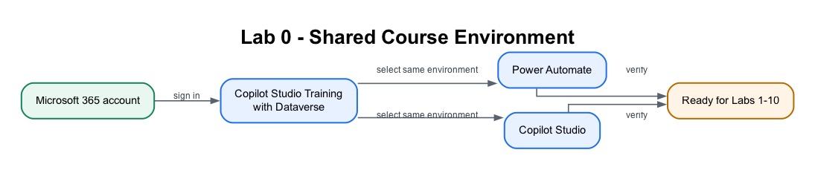
MODULE 1 · LAB WORKFLOW
Lab 0 — The Shared Course Environment
One Copilot Studio Training (Developer) environment, with Dataverse and Copilot Credits, stands behind every later lab.
LAB 0
Lab 0 — Environment Setup
Copilot Studio Training (Developer) environment · Power Platform admin centre · 40 min
Business Process Automation with Power Automate & Copilot Studio Agents · TGS-2022017524 · © 2026 Tertiary Infotech Academy Pte Ltd
23

Slide 24
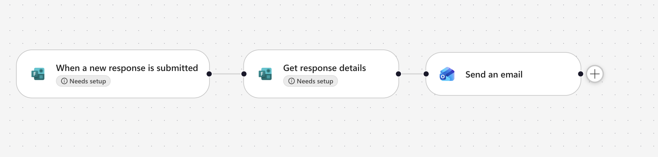
MODULE 1 · LAB WORKFLOW
Lab 1 — Form to Email Confirmation
A trigger starts a flow; actions consume the trigger's outputs as dynamic content.
LAB 1
Lab 1 — Trigger and Actions
Form to email confirmation · Power Automate + Microsoft Forms + Outlook · 40 min
Business Process Automation with Power Automate & Copilot Studio Agents · TGS-2022017524 · © 2026 Tertiary Infotech Academy Pte Ltd
24

Slide 25
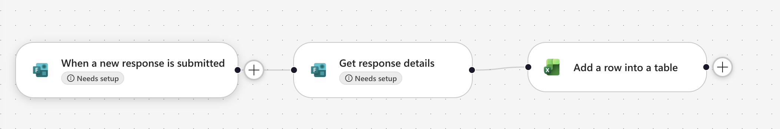
MODULE 1 · LAB WORKFLOW
Lab 2 — Log the Enquiry, Then Send
Commit before you confirm — the audit row is written before the acknowledgement is sent.
LAB 2
Lab 2 — Log to Excel
Log the enquiry, then send the email · Power Automate + Excel Online · 45 min
Business Process Automation with Power Automate & Copilot Studio Agents · TGS-2022017524 · © 2026 Tertiary Infotech Academy Pte Ltd
25

Slide 26
MODULE 2
Control Flow and Human in the Loop
Conditions and branching · approvals · in / on / out of the loop · where the human belongs
Applied in Lab 3
Business Process Automation with Power Automate & Copilot Studio Agents · TGS-2022017524 · © 2026 Tertiary Infotech Academy Pte Ltd
26

Slide 27
MODULE 2 · CONCEPT
Conditions — Both Paths Must Exist
A condition splits one run into two paths. Both paths must be built — including the one you hope never runs.
Condition
is the value X?
IF YES
IF NO
The approved path. Continue the business process.
The rejected path. Notify, record and stop — never fall silent.
Control action
What it does
Example in this course
Condition
One test, two branches
Approved or rejected
Switch
One value, many branches
Leave type: Annual / Medical / Unpaid
Apply to each
Repeat actions over a list
Every row returned by a lookup
Terminate
End the run deliberately
Stop with a status a reader can interpret
Business Process Automation with Power Automate & Copilot Studio Agents · TGS-2022017524 · © 2026 Tertiary Infotech Academy Pte Ltd
27

Slide 28
MODULE 2 · CONCEPT
Human In, On, and Out of the Loop
Three arrangements that people use interchangeably, and that are not the same thing.
Pattern
Who decides
Who acts
Can AI proceed alone?
Human IN the loop
AI proposes, human decides
Human authorises, system acts
NO — it blocks
Human ON the loop
AI decides and acts
Human monitors, can intervene
Yes — after the fact
Human OUT of the loop
AI decides and acts
AI acts
Yes — nobody checks
WHERE THIS COURSE PUTS THE HUMAN
Lab 3 — a manager approves leave. Lab 8 — a licensed adviser approves a draft before it is sent.
Labs 6, 7, 9 and 10 are deliberately out of the loop, so you can see what that costs.
LAB 3
Lab 3 — Leave Application Approval
The flow pauses for a manager · Power Automate + Approvals + Outlook · 45 min
Business Process Automation with Power Automate & Copilot Studio Agents · TGS-2022017524 · © 2026 Tertiary Infotech Academy Pte Ltd
28

Slide 29
MODULE 2 · CONCEPT
How an Approval Suspends a Running Flow
action
pause
decision
resume
Request
submitted
Start and wait
for an approval
The run
SUSPENDS
A person
responds
Condition reads
the Outcome
OUTCOME = APPROVE
OUTCOME = REJECT
Send the approval message, update the record and continue
the business process.
Send the rejection with the approver's comments, and route it
to a named person — never to silence.
SEND APPROVALS TO TEAMS, NOT OUTLOOK
Verified on a live tenant: Outlook created the request and never delivered the mail — the run sat at Running, looking healthy.
Every human gate in these labs uses the Microsoft Teams Approvals app.
LAB 3
Lab 3 — Leave Application Approval
The flow pauses for a manager · Power Automate + Approvals + Outlook · 45 min
Business Process Automation with Power Automate & Copilot Studio Agents · TGS-2022017524 · © 2026 Tertiary Infotech Academy Pte Ltd
29

Slide 30
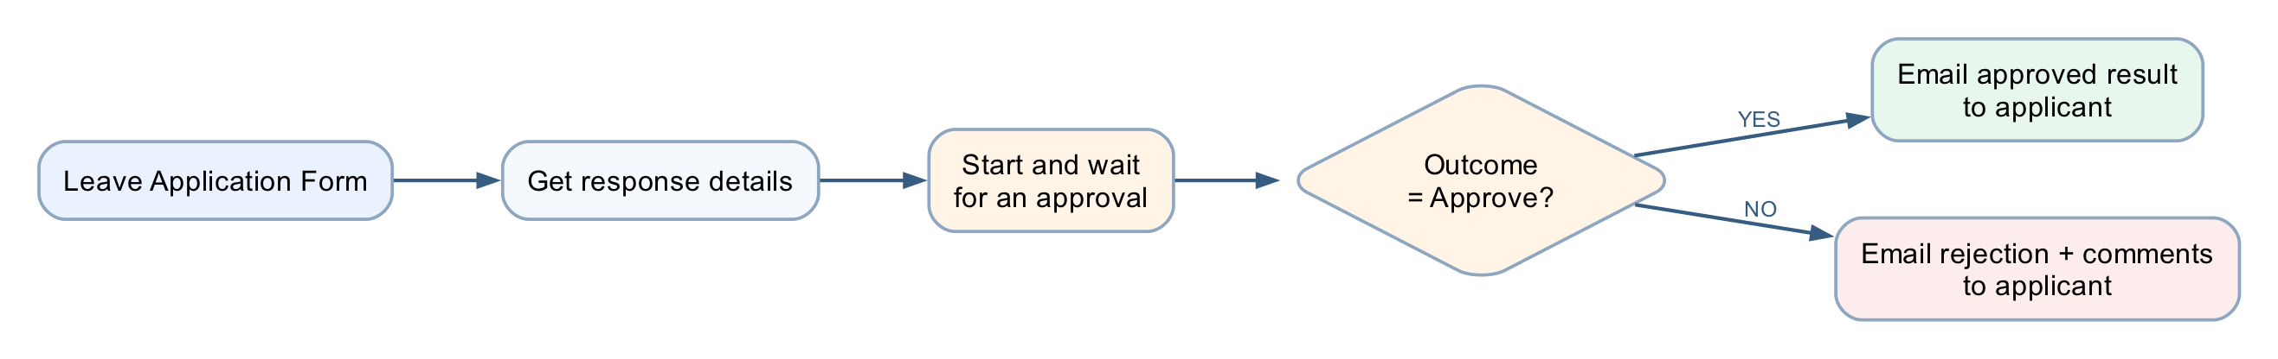
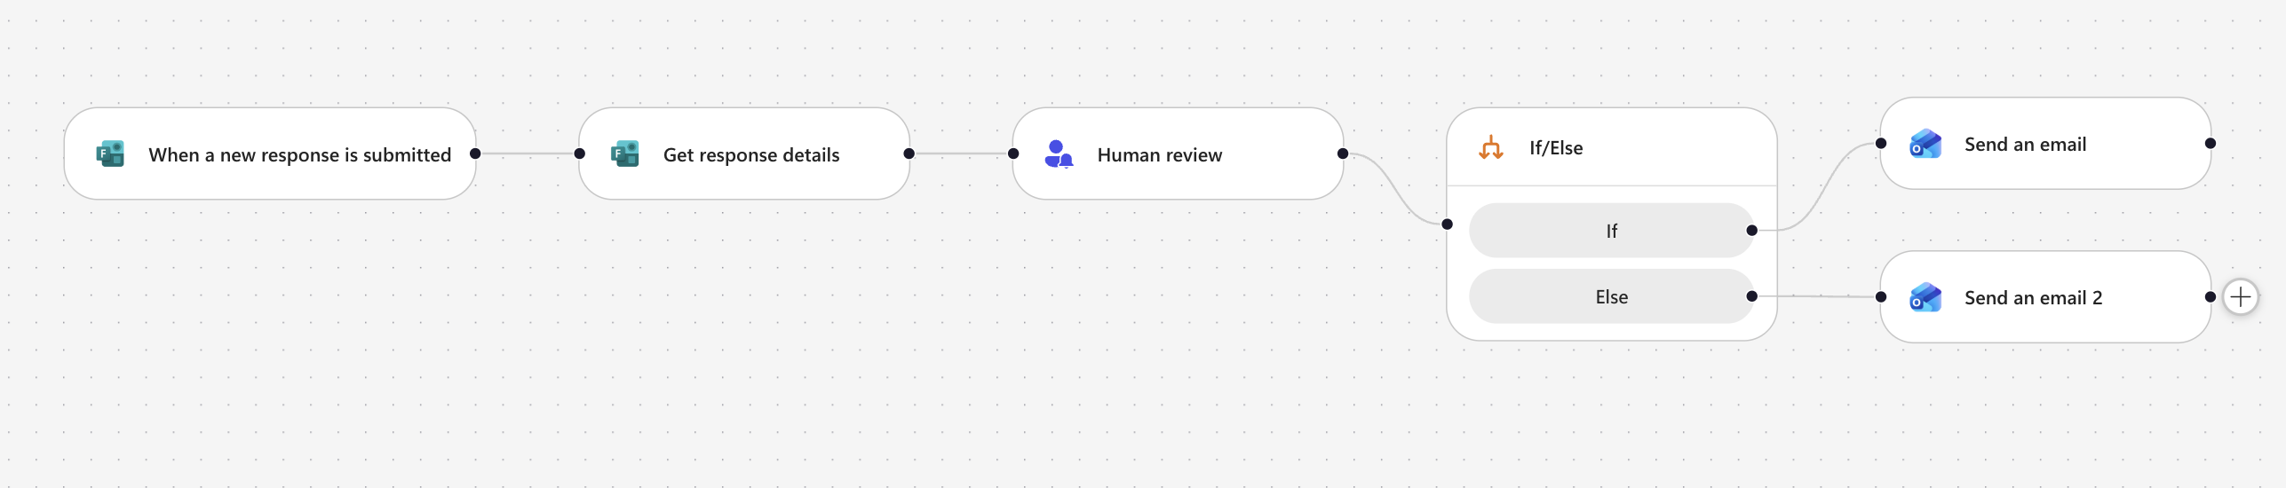
MODULE 2 · LAB WORKFLOW
Lab 3 — Leave Application Approval
A running flow suspends at the approval action and branches on the human decision.
LAB 3
Lab 3 — Leave Application Approval
The flow pauses for a manager · Power Automate + Approvals + Outlook · 45 min
Business Process Automation with Power Automate & Copilot Studio Agents · TGS-2022017524 · © 2026 Tertiary Infotech Academy Pte Ltd
30

Slide 31
MODULE 3
Copilot Studio Agents
The new Copilot Studio — model, harness, designer · workflow versus agent · instructions, skills, knowledge, tools · what is enforced · publishing
Applied in Labs 4, 4b, 5 and 5b
Business Process Automation with Power Automate & Copilot Studio Agents · TGS-2022017524 · © 2026 Tertiary Infotech Academy Pte Ltd
31

Slide 32
MODULE 3 · CONCEPT
Workflow or Agent — They Fail Differently
WORKFLOW — Power Automate
AGENT — Copilot Studio
• You decide the path in advance
• It chooses the path at run time
• The same input always gives the same output
• The same input may give a different answer
• It can only do what you built
• It can combine what it was given in new ways
• It fails loudly, at a named step
• It fails quietly, with a confident wrong answer
• You test it by checking the result
• You test it by trying to break it
Use a workflow where the rule is known. Use an agent where the language varies. Most real systems need both.
Labs 1–3 are pure workflow. Labs 4–5 are pure agent. Labs 6–10 are both, and the seam between them is the lesson.
Business Process Automation with Power Automate & Copilot Studio Agents · TGS-2022017524 · © 2026 Tertiary Infotech Academy Pte Ltd
32

Slide 33
MODULE 3 · CONCEPT
The New Copilot Studio — a Model Inside a Harness
Copilot Studio now separates the part that reasons from the part that governs. Two ideas name that split.
1
The AI model — the brain
2
The harness — around it
The reasoning engine. It understands language, spots patterns, generates content and decides what to do next. You choose it per agent — GPT-5.x or Claude — from the Model dropdown.
The orchestration layer the model works inside: context, tools, governance, workflows and security. The harness is model-agnostic — it turns reasoning into governed work.
ONE MODEL, THREE HARNESSES IT CAN WORK INSIDE
GitHub Copilot harness
Standard harness
Copilot chat harness
Reasoning-heavy agents and workflows. Takes a goal, breaks it into steps, uses skills and memory, edits files in a governed sandbox. Billed in Copilot Credits.
Rule-based agents and structured, repeatable conversations. You author the topics and paths, so the behaviour is predictable for well-understood requests.
Extends Microsoft 365 Copilot Chat with your enterprise knowledge, so employees get grounded answers inside the chat they already use.
Everything you build in Labs 4–10 is a model you chose, inside a harness you configure.
Business Process Automation with Power Automate & Copilot Studio Agents · TGS-2022017524 · © 2026 Tertiary Infotech Academy Pte Ltd
33

Slide 34
MODULE 3 · CONCEPT
Choosing a Harness
Consideration
GitHub Copilot harness
Standard harness
Copilot chat harness
Best for
Complex, multi-step business processes
Rule-based agents, structured conversations
Extending M365 Copilot Chat
How it works
Reasons through a goal, step by step
Follows the topics and rules you define
Connects enterprise knowledge to chat
When a step fails
Retries, or finds another path
Follows only the paths you built
Not a focus
Works with files
Creates and edits Word, Excel, PowerPoint, PDF
Not a focus
Not a focus
Skills and memory
Yes — core building blocks
Not a focus
Not a focus
Billing
Copilot Credits — you pay for usage when you build and when you publish
Copilot Studio licensing
Consumption, or M365 Copilot seats
Start with the simplest harness that meets the need — a retrieval agent that only answers from documents does not need the reasoning loop.
Business Process Automation with Power Automate & Copilot Studio Agents · TGS-2022017524 · © 2026 Tertiary Infotech Academy Pte Ltd
34

Slide 35
MODULE 3 · CONCEPT
Modern Orchestration — the Loop Replaces the Plan
The standard harness builds a plan, then runs it. The GitHub Copilot harness keeps deciding from the latest state.
STANDARD — PLAN, THEN EXECUTE
GITHUB COPILOT — THOUGHT · ACTION · OBSERVATION
1. INTENT
understand
2. PLAN
synthesise steps
3. EXECUTE
run the plan
THOUGHT
ACTION
latest
state
An explicit plan object: collect inputs, execute actions, summarise. Less live replanning and easier to inspect — but a detour or a failed step ends the plan.
DECIDE
OBSERVE
Reason over the latest state, call a tool, read the result, choose the next step live. It retries or reroutes on failure, and picks the task back up after a detour.
What the loop buys: fewer, smarter questions (it infers what it already knows) · handles detours without losing the task · chains and parallelises tools · recovers from errors instead of surfacing them.
The loop fits problem spaces you cannot map upfront. Where the path is known, that freedom is cost, not value — keep it in a workflow.
Business Process Automation with Power Automate & Copilot Studio Agents · TGS-2022017524 · © 2026 Tertiary Infotech Academy Pte Ltd
35

Slide 36
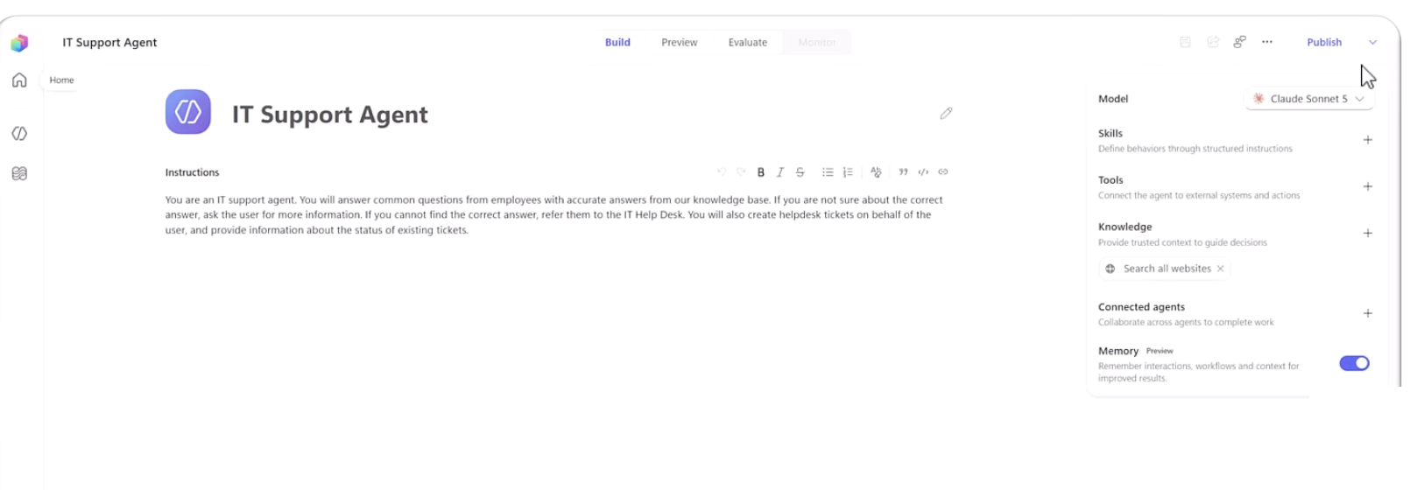
MODULE 3 · CONCEPT
The New Agent Designer
One page
Four tabs
Model picker
Memory (preview)
Skills, Tools, Knowledge, Connected agents and Memory, all on one rail.
Build · Preview · Evaluate · Monitor — author, probe, score, then watch it live.
GPT-5.x or Claude, chosen per agent — the harness stays the same.
Per-user remembered context. A maker toggle — off means unused.
Everything Lab 4 builds — instructions, skills, knowledge, tools — has a single home in this designer.
Business Process Automation with Power Automate & Copilot Studio Agents · TGS-2022017524 · © 2026 Tertiary Infotech Academy Pte Ltd
36

Slide 37
MODULE 3 · CONCEPT
The Anatomy of an Agent
INSTRUCTIONS
SKILLS
Who it is and what it must
never do. Always in force.
Named procedures, applied
when the topic matches.
THE AGENT
name · model · description
KNOWLEDGE
TOOLS
Documents it may read.
It cannot read anything else.
Flows it can call to act
outside the conversation.
A fifth part — CONNECTED AGENTS — lets one agent hand a conversation to another with its own knowledge and audience.
LAB 4
Lab 4 — Agents
Procurement, HR, Sales and IT Support · Copilot Studio agents + agent flows + SharePoint + Teams · 45 min
Business Process Automation with Power Automate & Copilot Studio Agents · TGS-2022017524 · © 2026 Tertiary Infotech Academy Pte Ltd
37

Slide 38
MODULE 3 · CONCEPT
Which Parts of an Agent Hold — and Which Do Not
The spine of Lab 4: which of an agent's five parts can the model ignore?
Part
What it is
Enforced?
Instructions
Who the agent is, always in force
NO — probabilistic
Skill
A named procedure for a matching topic
NO — the model decides it applies
Knowledge
Documents the agent may read
PARTLY — it cannot read what it lacks
Tool
A flow that acts outside the conversation
YES — the flow's own logic is enforced
Connected agent
A separate agent, its own knowledge
YES — the knowledge boundary is real
A control the model cannot reach beats a rule you asked it to follow.
So: a tool the agent does NOT have is a control. And the schema beats the prompt — a field that exists will eventually be filled.
Business Process Automation with Power Automate & Copilot Studio Agents · TGS-2022017524 · © 2026 Tertiary Infotech Academy Pte Ltd
38

Slide 39
MODULE 3 · CONCEPT
Writing Instructions That Constrain
Instructions are prose, but they are not free text. Four things every agent instruction in this course states.
1
Identity
3
Refusals
"You are an HR policy information assistant."
One role, stated in one line.
"Do not expose, request or infer personal employee records."
Stated as prohibitions, not preferences.
2
Source rule
4
Escalation
"Answer using only the approved SharePoint HR policy source."
Where facts may come from.
"When the source is insufficient, say so and direct the user to HR."
Where the conversation ends when it cannot continue.
NEVER PASTE @{...} INTO AN INSTRUCTIONS BOX
It is a rich-text editor: it escapes underscores in node names, and a reference to a node that does not exist resolves to
EMPTY rather than erroring. Build the prose with gaps and insert every value with the ⚡ picker.
Business Process Automation with Power Automate & Copilot Studio Agents · TGS-2022017524 · © 2026 Tertiary Infotech Academy Pte Ltd
39

Slide 40
MODULE 3 · CONCEPT
Skills — Instructions on Demand
TOPICS
SKILLS
Topics were built for scripted chatbots — not for how these models think. A skill gives the agent a specific, repeatable task and the material to carry it out.
authored conversational paths —
the legacy way to build chatbots
reusable procedures, loaded
when the scenario matches
What a skill is
Why it works
What to avoid
Name + description are the routing metadata; the instructions are the core, with examples, resources and scripts alongside. Metadata sits in context — the full content loads only when the scenario fires.
The instruction page stays short and readable, and context loads on demand. A large always-on prompt makes the model weigh irrelevant guidance on every turn.
Vague descriptions (the skill mis-fires or never triggers) · mega-skills that do everything · fact dumps — a skill guides, it does not replace a knowledge source.
A skill is still not enforced — the model decides that it applies. The enforcement table you just saw is unchanged.
Business Process Automation with Power Automate & Copilot Studio Agents · TGS-2022017524 · © 2026 Tertiary Infotech Academy Pte Ltd
40

Slide 41
MODULE 3 · CONCEPT
Knowledge — Giving Facts and Removing Sources
point at it
wait for Ready
at run time
Documents in
SharePoint
Attached as a
knowledge source
Indexed by
the product
Retrieved when
a question matches
1
It is a boundary
2
Turn off general knowledge
3
Remove "Search all websites"
The agent genuinely cannot read a document you did not give it. This is the one part of the agent that is close to enforced.
Otherwise the model answers from what it learned in training, and you cannot tell which answers those were.
It is on by default. A fee from the open web is indistinguishable from a fee in your own brochure.
Grounding is not only about giving the agent facts. It is about taking away every other source of them.
LAB 9
Lab 9 — RAG with Knowledge Base
Cook & Bake Academy, built-in knowledge · Copilot Studio Knowledge + SharePoint · 40 min
Business Process Automation with Power Automate & Copilot Studio Agents · TGS-2022017524 · © 2026 Tertiary Infotech Academy Pte Ltd
41

Slide 42
MODULE 3 · CONCEPT
Tools — Where the Agent Stops and the Flow Starts
intent
typed inputs
Respond to the agent
User asks
for something
Agent decides
a tool applies
Flow runs —
deterministic
Result returns
to the conversation
THE AGENT'S PART
THE FLOW'S PART
Decides that a tool is relevant, and fills its inputs from
what the person said.
This part is probabilistic. It may call the wrong tool, or
call the right one with the wrong values.
Validates, looks up, applies the threshold, writes the audit
row, sends to the approver.
This part is enforced. Whatever the agent believed, the
flow's own logic still runs.
The tool description is how the agent knows when to call it — write it for the model, not for a developer.
LAB 4
Lab 4 — Agents
Procurement, HR, Sales and IT Support · Copilot Studio agents + agent flows + SharePoint + Teams · 45 min
Business Process Automation with Power Automate & Copilot Studio Agents · TGS-2022017524 · © 2026 Tertiary Infotech Academy Pte Ltd
42

Slide 43
MODULE 3 · CONCEPT
Multiple Agents — A Split Is a Governance Decision
One agent that knows everything has no boundaries. Splitting is how you give it some.
HR AGENT
the parent
Policy &
Benefits
Leave
Onboarding
Payroll
Knowledge is separated
Conversation is not
A split is governance
Each child reads only its own documents. That boundary is real.
What the employee said still flows across. Privacy is not automatic.
You are deciding who may know what — not tidying a big prompt.
LAB 4
Lab 4 — Agents
Procurement, HR, Sales and IT Support · Copilot Studio agents + agent flows + SharePoint + Teams · 45 min
Business Process Automation with Power Automate & Copilot Studio Agents · TGS-2022017524 · © 2026 Tertiary Infotech Academy Pte Ltd
43

Slide 44
MODULE 3 · CONCEPT
Agent Settings
Every agent has a Settings page. Two of its switches decide how this course's agents behave — and neither takes effect until you save and publish.
Agent settings
The toggle behind Labs 4 & 4b
ⓘ Changes to settings take effect after you save and publish the agent.
A child agent can only be invoked as a connected agent while Allow other agents to connect is on. Manager cannot delegate to a child that has it off.
Agent details
AI & behavior
Tune how the agent responds, reasons, and communicates.
AI & behavior
Orchestration
Moderation is a platform control
Allow other agents to connect
The moderation filter runs outside the model at the level you set — a structural control, not an instruction the agent could be talked out of.
Safety & access
Let other agents in your organization invoke this agent as a tool.
Greeting & prompts
Safety
Nothing bites until publish
Moderation level
Medium ⌄
Settings changes apply only after save and publish. A changed setting that “does nothing” is usually just unpublished.
Controls how strictly responses are filtered for unsafe content.
LAB 4B
Lab 4b — Multi-Agent Content Team
Marketing Manager, Research, Blog and Review · Copilot Studio connected agents · 60–75 min · optional
Business Process Automation with Power Automate & Copilot Studio Agents · TGS-2022017524 · © 2026 Tertiary Infotech Academy Pte Ltd
44

Slide 45
MODULE 3 · CONCEPT
Publishing to Teams
probe it
version
Teams / web
verify
Build and
save
Test in
Preview
Publish
Add a
channel
Users reach it
in Teams
1
Preview is not published
2
One change per cycle
3
Test as the user
Changes are invisible to Teams users until you publish again. A stale answer in Teams usually means an unpublished edit.
Each publish-and-test cycle costs a publish plus about 25 seconds. Two simultaneous edits make a failure uninterpretable.
Open it from Teams with the account a real user would have — not from the maker's Preview pane.
LAB 5
Lab 5 — Calling Agent from Workflow
Blog-writer agent flow · Copilot Studio + M365 Copilot + Teams · 30 min
Business Process Automation with Power Automate & Copilot Studio Agents · TGS-2022017524 · © 2026 Tertiary Infotech Academy Pte Ltd
45

Slide 46
MODULE 3 · CONCEPT
Publishing an Agent — Channels
Publish makes a version live — a channel decides who can reach it. The publish dialog lists the channels; none of them serves your edits until you publish again.
Agent published
Demo Website first
✓ Last published today, 7:46 PM
The shareable link is the fastest way to put the agent in a tester's hands — no Teams, no admin, anyone with the link.
Demo Website
Teams + Microsoft 365
Shareable web link for anyone to use
Channel enabled
Teams + Microsoft 365
Available in Copilot and Teams chats — Outlook, Word, Excel, PowerPoint and OneDrive.
Enable this channel and the agent appears in Teams chat and Microsoft 365 Copilot — where colleagues already work.
Web app
Embed your agent into a website
✓
Make agent available in Microsoft 365 Copilot
Publishing to the Agent Store inside Microsoft 365 Copilot goes through your admin's approval.
Publish, then re-publish
Teams + Microsoft 365
✓
Available in Copilot and Teams chats
Channels serve the published version only. Every later edit is invisible to users until you publish again.
See agent in Microsoft 365 · See agent in Teams
LAB 4
Lab 4 — Agents
The _deployment step publishes each agent to Microsoft Teams · Copilot Studio agents · 45 min
Business Process Automation with Power Automate & Copilot Studio Agents · TGS-2022017524 · © 2026 Tertiary Infotech Academy Pte Ltd
46

Slide 47
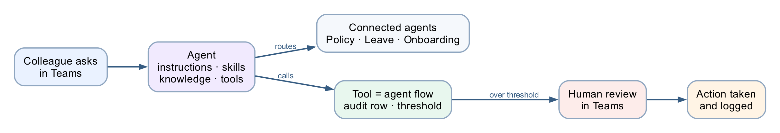
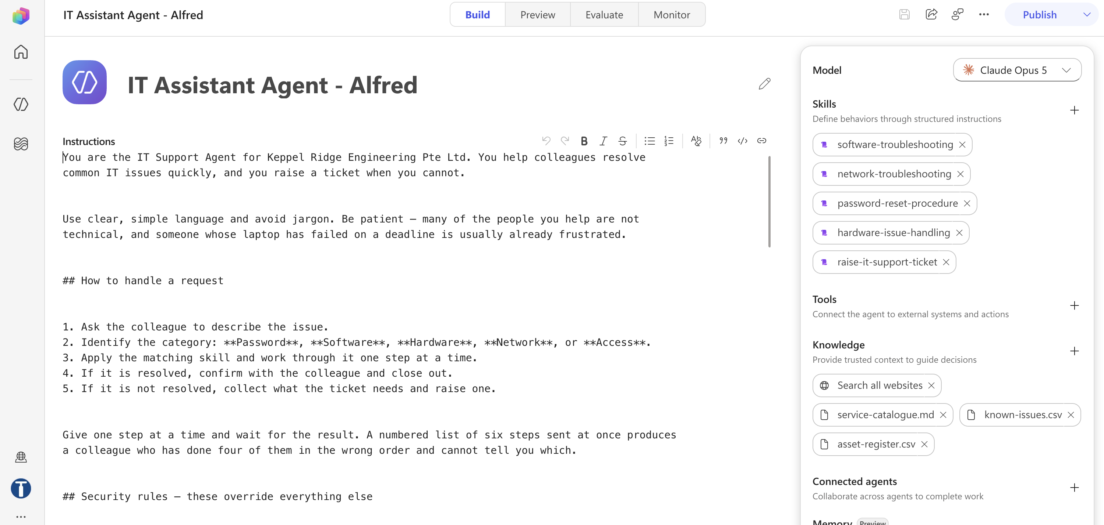
MODULE 3 · LAB WORKFLOW
Lab 4 — Four Agents, One Spine
An agent is instructions, skills, knowledge, tools and connected agents — and only some of those are enforced.
LAB 4
Lab 4 — Agents
Procurement, HR, Sales and IT Support · Copilot Studio agents + agent flows + SharePoint + Teams · 45 min
Business Process Automation with Power Automate & Copilot Studio Agents · TGS-2022017524 · © 2026 Tertiary Infotech Academy Pte Ltd
47

Slide 48
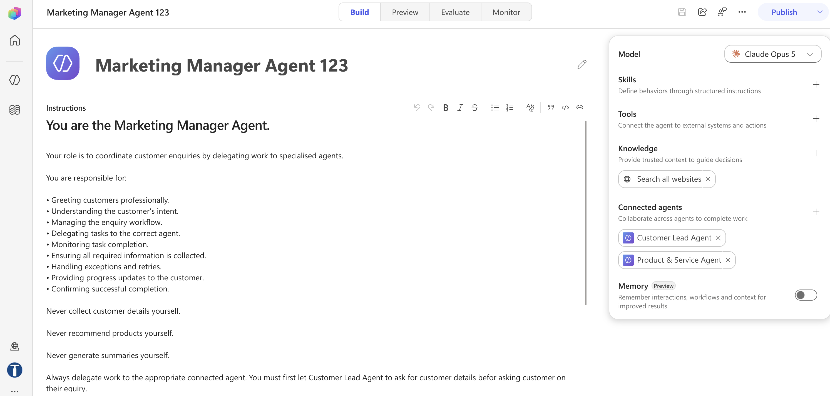
MODULE 3 · LAB WORKFLOW
Lab 4b — Multi-Agent Content Team
One topic, four agents: the Marketing Manager owns the conversation and delegates by stage of work — and nothing is final until a person approves.
HUMAN
MARKETING
MANAGER
RESEARCH
AGENT
BLOG
AGENT
REVIEW
AGENT
HUMAN
gives the topic
orchestrates,
never writes
brochures + web,
labelled apart
writes from the
brief, no web
checklist; did not
write the draft
approves the
final post
LAB 4B
Lab 4b — Multi-Agent Content Team
Research → draft → review → human approval · Copilot Studio connected agents · 60–75 min · optional
Business Process Automation with Power Automate & Copilot Studio Agents · TGS-2022017524 · © 2026 Tertiary Infotech Academy Pte Ltd
48

Slide 49
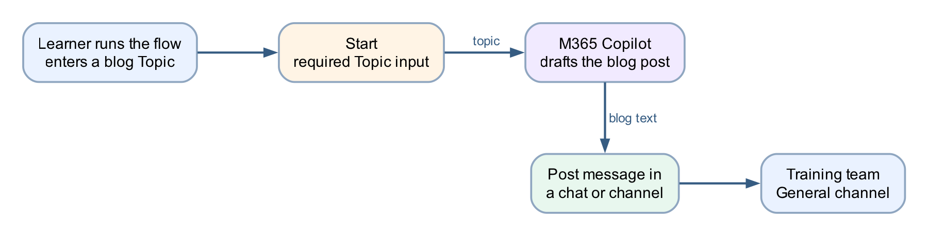
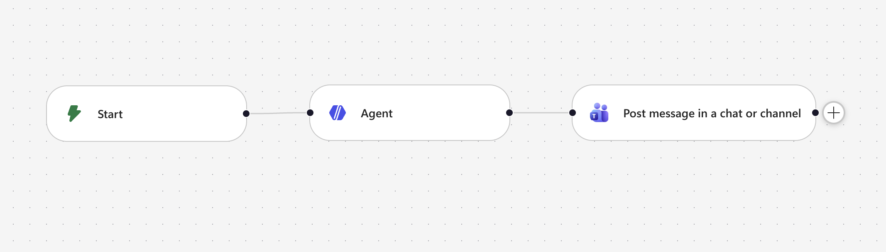
MODULE 3 · LAB WORKFLOW
Lab 5 — Calling Agent from Workflow
Build an agent flow that collects a blog topic at the Start node, drafts the post with M365 Copilot, and posts it to the Training team's General channel.
LAB 5
Lab 5 — Calling Agent from Workflow
Blog-writer agent flow · Copilot Studio + M365 Copilot + Teams · 30 min
Business Process Automation with Power Automate & Copilot Studio Agents · TGS-2022017524 · © 2026 Tertiary Infotech Academy Pte Ltd
49

Slide 50
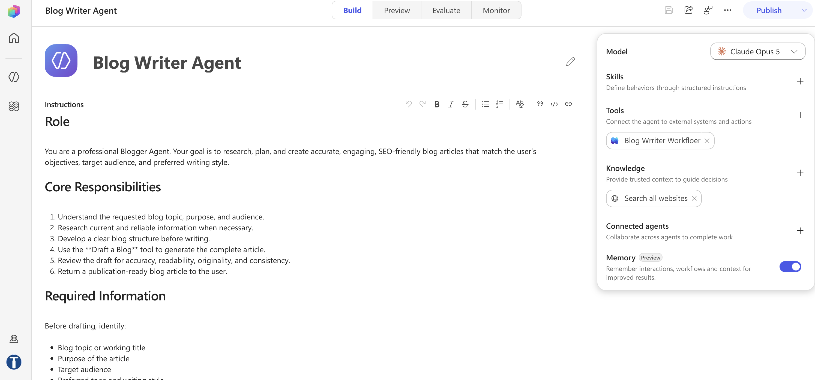
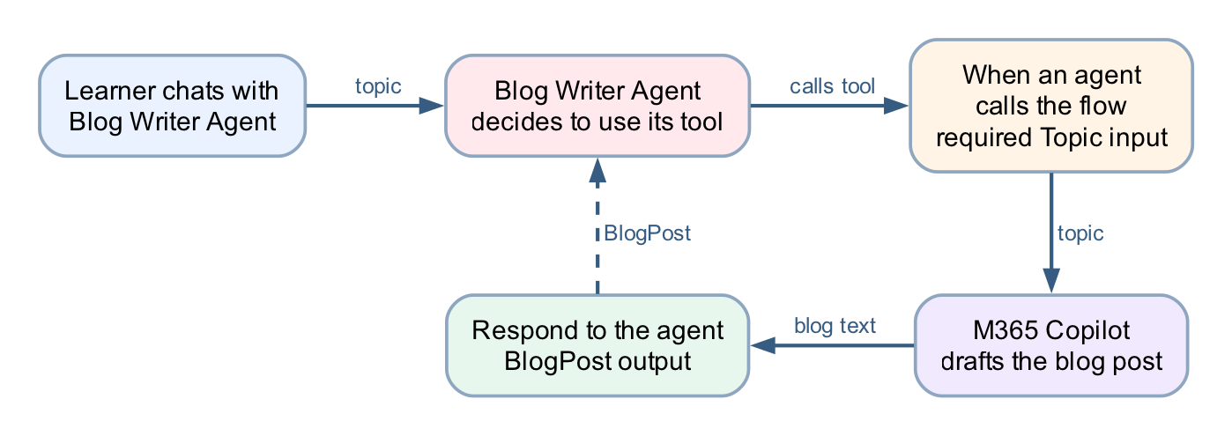
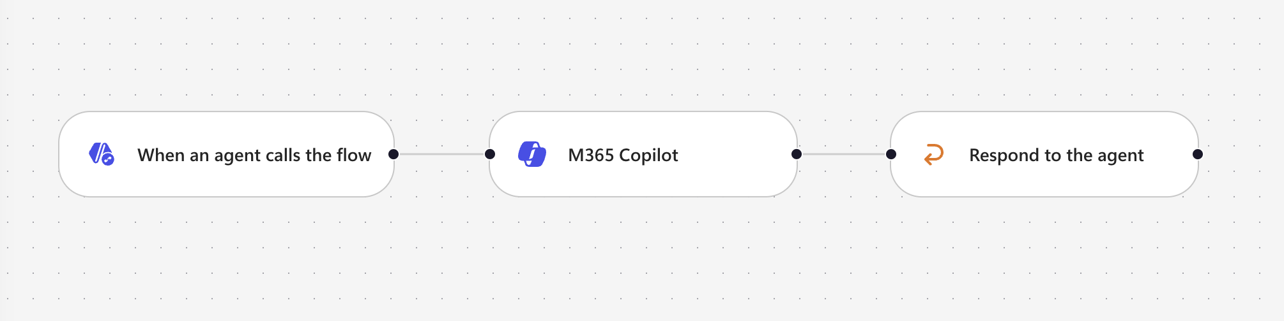
MODULE 3 · LAB WORKFLOW
Lab 5b — Calling Workflow from Agent
The mirror image of Lab 5: the agent decides when to call the workflow, and the flow's inputs and outputs are the contract it programs against.
LAB 5B
Lab 5b — Calling Workflow from Agent
Blog Writer Agent runs the flow as its tool · Copilot Studio + M365 Copilot · 30 min
Business Process Automation with Power Automate & Copilot Studio Agents · TGS-2022017524 · © 2026 Tertiary Infotech Academy Pte Ltd
50

Slide 51
MODULE 4
Agent Flows, HTTP and the Boundary of Agency
The new workflow designer · the Agent node inside a flow · HTTP request and response · structured output · the human review gate
Applied in Lab 6, Lab 7 and Lab 8
Business Process Automation with Power Automate & Copilot Studio Agents · TGS-2022017524 · © 2026 Tertiary Infotech Academy Pte Ltd
51

Slide 52
MODULE 4 · CONCEPT
Agent Flows — The Model Inside the Workflow
An agent flow is a Power Automate flow that may contain an Agent node — the model, inside the workflow.
JSON in
clean
facts
structured
act
HTTP trigger
Compose
normalise
SharePoint
lookup
AGENT
apply the rules
Condition
on the decision
Response
WHAT THE AGENT NODE IS FOR
THE COPILOT CREDITS TRAP
Judgement over language: reading a free-text reason,
applying ordered rules, classifying a tone, drafting a reply.
Anything where the input varies more than a form allows.
Agent flows consume Copilot Credits on every run. Many
Default environments have none and fail with
InsufficientMcsCredits. A licence does not fix it — licences
are per-user, credits are per-environment.
This is why Lab 0 builds a Copilot Studio Training (Developer) environment rather than a Sandbox.
Business Process Automation with Power Automate & Copilot Studio Agents · TGS-2022017524 · © 2026 Tertiary Infotech Academy Pte Ltd
52

Slide 53
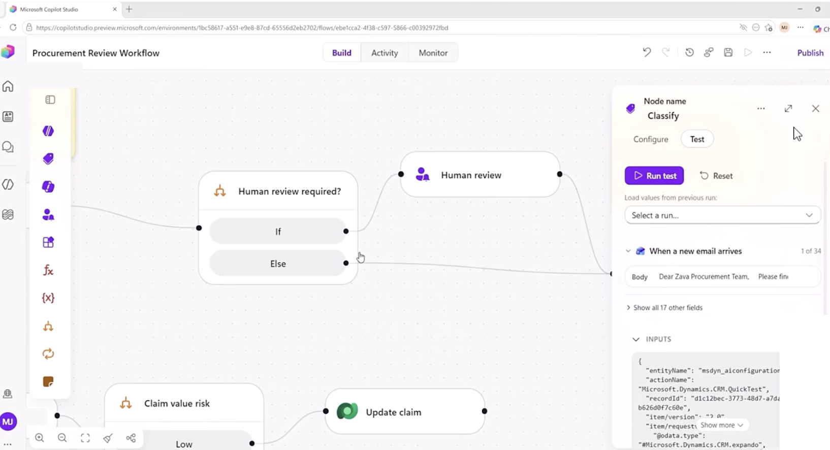
MODULE 4 · CONCEPT
The New Workflow Designer
A visual canvas
Deterministic steps drawn as nodes — AI only where a step needs judgement.
Node-by-node testing
Run test on one node, with values loaded from a previous run.
Agents inside workflows
Drop an inline agent into one step, or call a published agent as a tool.
MCP-enabled tools
Connectors and MCP tools, inside the Microsoft security boundary.
Workflows keep the structure of agent flows and add the intelligence of agents — without the unpredictability.
Business Process Automation with Power Automate & Copilot Studio Agents · TGS-2022017524 · © 2026 Tertiary Infotech Academy Pte Ltd
53

Slide 54
MODULE 4 · CONCEPT
HTTP — A Website Calls Your Flow and Waits
submit
over HTTPS
build reply
render
Website form
POST JSON
HTTP trigger
receives it
Flow runs
Response
returns JSON
Page updates
Part
Meaning
In these labs
Request
What the caller sends
A JSON body matching the schema you declared
Schema
The shape you promise to accept
Generated from a sample payload — then frozen
Response
What the caller gets back
A JSON body the page can read, plus a status code
Synchronous
The page waits
If nothing responds, the browser sees a timeout, not a result
TWO FAILURES THAT LOOK THE SAME FROM THE BROWSER
"Failed to fetch" WITH a successful run = CORS; serve the page from SharePoint, not localhost. "Failed to fetch" with NO run at all = the flow is saved but not published, or the URL is wrong.
Business Process Automation with Power Automate & Copilot Studio Agents · TGS-2022017524 · © 2026 Tertiary Infotech Academy Pte Ltd
54

Slide 55
MODULE 4 · CONCEPT
Structured Output — Fields, Not Prose
Structured output turns the model's answer from prose into named fields the rest of the flow can branch on.
PROSE — unusable downstream
STRUCTURED — branchable
"I think this application should probably be approved,
although the address looks a little unusual and you
may wish to check it."
What does a Condition test against that?
applicationId : APP-10432
decision : REVIEW
reason : address unverified
riskFlags : [ADDRESS_MISMATCH]
A Condition can read decision. A person can audit reason.
FOUR DECISIONS, NOT TWO
APPROVED · REJECTED · DUPLICATE · REVIEW
A politically exposed person is not a rejection — it is a case for a human. An agent given only two outcomes will force
every ambiguous case into one of them, and you will never see the ones it got wrong.
LAB 6
Lab 6 — HTTP and Application Approval Agent
Marina Trust Bank customer onboarding · Copilot Studio agent flow + SharePoint + Outlook · 60 min
Business Process Automation with Power Automate & Copilot Studio Agents · TGS-2022017524 · © 2026 Tertiary Infotech Academy Pte Ltd
55

Slide 56
MODULE 4 · CONCEPT
The Boundary of Agency
The most important design decision in the course: what the model is allowed to determine, and what it is not.
THE AI DECIDES — what to do
THE FLOW DOES — what must always happen
• Which of six ordered rules applies
• Normalise the identifier (Compose)
• Whether the case needs a human
• Check the register for a duplicate
• How to phrase the reason
• Write the customer record
• What risk flags to raise
• Write the audit row, before the gate
THE RECORD IS WRITTEN FROM THE COMPOSE ACTION, NEVER FROM THE MODEL'S ANSWER
So an invented identifier has no route into the customer master. The agent's opinion reaches the decision field; it never
reaches the data. If you remember one sentence from Day 2, make it this one.
LAB 6
Lab 6 — HTTP and Application Approval Agent
Marina Trust Bank customer onboarding · Copilot Studio agent flow + SharePoint + Outlook · 60 min
Business Process Automation with Power Automate & Copilot Studio Agents · TGS-2022017524 · © 2026 Tertiary Infotech Academy Pte Ltd
56

Slide 57
MODULE 4 · CONCEPT
The Agent Alone, in Public
Lab 7 is the agent working in public with nobody reviewing it. Four nodes, and two non-negotiable rules.
POST
instruction · knowledge · history
reply
Chat widget
HTTP trigger
Compose
session
AGENT
rules + facts
Response
RULES LIVE IN THE INSTRUCTION
FACTS LIVE IN THE KNOWLEDGE SOURCE
Collect name, phone and email before answering. Never
recommend a product, predict a return or allocate savings.
A refusal that must be retrieved can miss.
Fees, timelines and services come from the FAQ PDF.
Change the PDF and the answers change — without
touching the instruction.
The test cases in Lab 7 are written to make it fail. Read the failures aloud — that is the debrief.
LAB 7
Lab 7 — HTTP and Chatbot
Investment advisor chatbot · Copilot Studio + SharePoint knowledge + static website · 40 min
Business Process Automation with Power Automate & Copilot Studio Agents · TGS-2022017524 · © 2026 Tertiary Infotech Academy Pte Ltd
57

Slide 58
MODULE 4 · CONCEPT
The Human Review Node — A Gate That Blocks
Lab 8 adds the person back. The Human review node does nothing at all except wait.
THE AGENT'S TERRITORY
THE GATE
THE CONSEQUENCE
classify
read tone
flag
DRAFT
Human review
approve / reject
in Teams
send · log ·
hand to a named person
THE TEST OF A REAL GATE
Submit an enquiry, then open Activity. The run says Running — and it will still say Running tomorrow. Nothing times out,
nothing defaults, nothing proceeds. A workflow that has done all of its work and will not take the last step.
That pause is the deliverable. Rejected drafts go to a NAMED person who must phone the client — never to silence.
LAB 8
Lab 8 — HTTP and Human Review
Client rapport assistant with a Teams approval gate · Copilot Studio + Human review + Excel Online + Outlook + Teams · 60 min
Business Process Automation with Power Automate & Copilot Studio Agents · TGS-2022017524 · © 2026 Tertiary Infotech Academy Pte Ltd
58

Slide 59
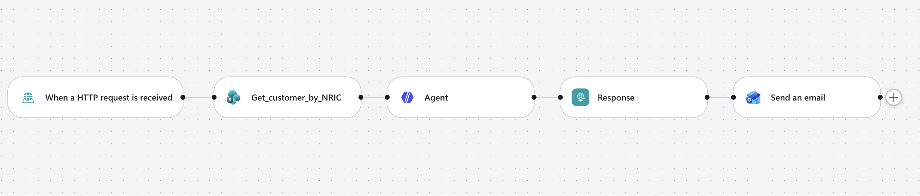
MODULE 4 · LAB WORKFLOW
Lab 6 — Application Approval Agent
The boundary of agency — the AI decides what to do; deterministic actions do what must always happen.
LAB 6
Lab 6 — HTTP and Application Approval Agent
Marina Trust Bank customer onboarding · Copilot Studio agent flow + SharePoint + Outlook · 50 min
Business Process Automation with Power Automate & Copilot Studio Agents · TGS-2022017524 · © 2026 Tertiary Infotech Academy Pte Ltd
59

Slide 60
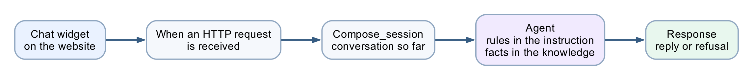
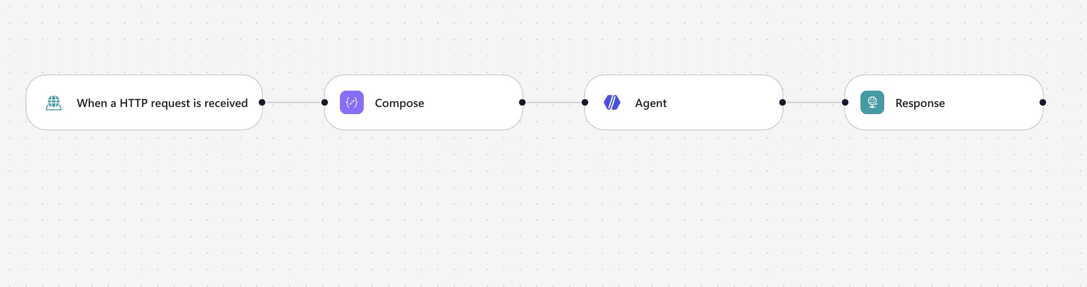
MODULE 4 · LAB WORKFLOW
Lab 7 — The Chatbot, Working Alone
The agent alone — rules in the instruction, facts in the knowledge source, and a refusal it must never break.
LAB 7
Lab 7 — HTTP and Chatbot
Investment advisor chatbot · Copilot Studio + SharePoint knowledge + static website · 40 min
Business Process Automation with Power Automate & Copilot Studio Agents · TGS-2022017524 · © 2026 Tertiary Infotech Academy Pte Ltd
60

Slide 61
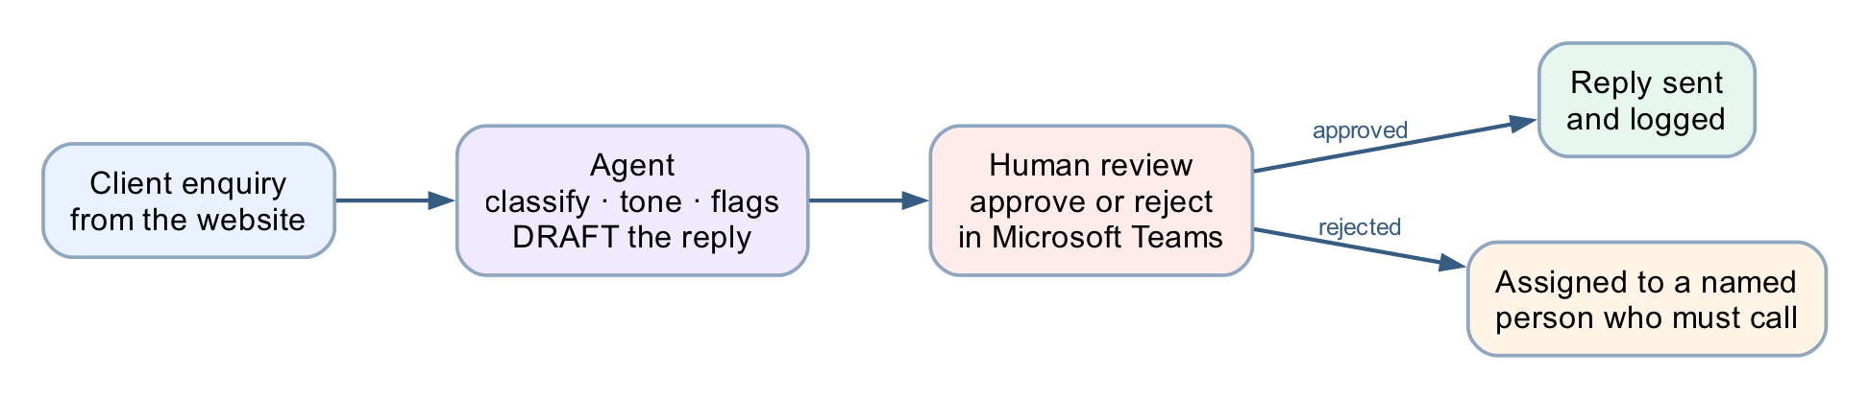
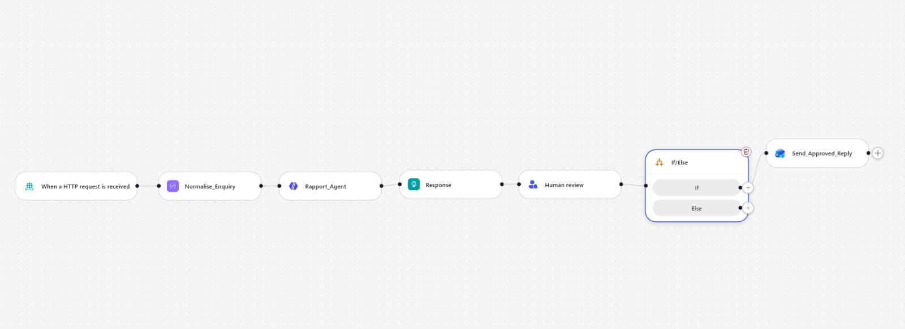
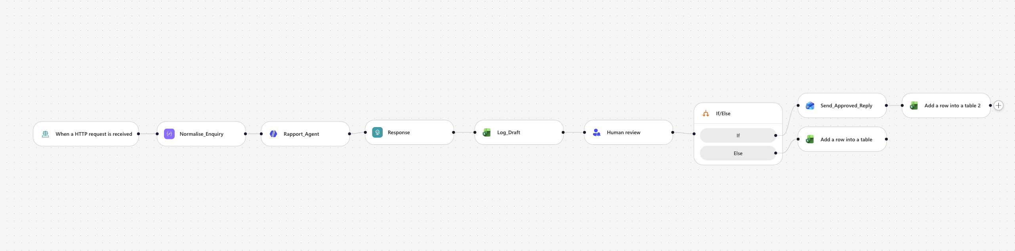
MODULE 4 · LAB WORKFLOW
Lab 8 — The Human Review Gate
Human in the loop — the AI drafts, and the workflow physically cannot proceed until a person approves.
LAB 8
Lab 8 — HTTP and Human Review
Client rapport assistant with a Teams approval gate · Copilot Studio + Human review + Outlook + Teams · 60 min
Business Process Automation with Power Automate & Copilot Studio Agents · TGS-2022017524 · © 2026 Tertiary Infotech Academy Pte Ltd
61

Slide 62
MODULE 5
Retrieval Augmented Generation
Why not just paste everything · ingestion and retrieval · chunking, embeddings, top_k · built-in versus external · probing for invention
Applied in Lab 9 and Lab 10
Business Process Automation with Power Automate & Copilot Studio Agents · TGS-2022017524 · © 2026 Tertiary Infotech Academy Pte Ltd
62

Slide 63
MODULE 5 · CONCEPT
Why Retrieval, Rather Than a Bigger Prompt
You could paste all 20 brochures into the instruction. For 20 it works. Then the academy adds 40 more.
EVERYTHING IN THE PROMPT
RETRIEVE, THEN GENERATE
The instruction exceeds what the model can read.
It starts ignoring the middle.
Every question costs the price of 60 brochures.
A fee change means editing the prompt.
Find the two or three brochures that resemble the
question, and give the model only those.
The agent never sees the other 17.
It answers from what matters.
vector
similarity
top_k
generate
Question
Embed the
question
Search for the
nearest documents
Paste them into
the prompt
Grounded
answer
RAG = retrieval + generation. The retrieval decides whether the generation can possibly be right.
Business Process Automation with Power Automate & Copilot Studio Agents · TGS-2022017524 · © 2026 Tertiary Infotech Academy Pte Ltd
63

Slide 64
MODULE 5 · CONCEPT
The RAG Pipeline, and the Four Words That Matter
Two phases. Ingestion happens once; retrieval happens on every question.
INGESTION — once
split
model
index
Documents
Chunk
Embed
Store as vectors
RETRIEVAL — every question
same model
similarity
context
Question
Embed
Nearest top_k
Into the prompt
Answer
Chunk
Embedding
Similarity
top_k
How a document is split. Here: one brochure = one record.
Text as a list of numbers. llama-text-embed-v2, 1024 dimensions.
Nearness of two vectors — the machine's idea of "related".
How many documents come back. Here: 3.
Business Process Automation with Power Automate & Copilot Studio Agents · TGS-2022017524 · © 2026 Tertiary Infotech Academy Pte Ltd
64

Slide 65
MODULE 5 · CONCEPT
Built-in Knowledge or Your Own Vector Store
LAB 9 — built-in knowledge
LAB 10 — Pinecone
Nodes
3
5
Ingestion
Upload to SharePoint
A Python script, run once
Embedding model
Hidden
llama-text-embed-v2, 1024
Chunking
Hidden
One brochure = one record — your call
top_k
Hidden
3 — your call
Citation markers
Leak into the reply
None
A changed fee
Edit, wait for re-crawl
Edit, then re-ingest
When it answers badly
Rewrite the prompt and hope
Four levers to pull
Neither is the right answer. Which is right depends on whether the person maintaining it will ever need those levers.
Business Process Automation with Power Automate & Copilot Studio Agents · TGS-2022017524 · © 2026 Tertiary Infotech Academy Pte Ltd
65

Slide 66
MODULE 5 · CONCEPT
Probing for Invention
A grounded agent still invents. You find out by asking for things that do not exist.
A course you do not run
A fact in no brochure
A discount that does not exist
"Do you have a course on cake sculpture?"
"Is there parking at the east campus?"
"What is the student discount?"
It must say it does not — not improvise a syllabus.
It must say the brochures do not cover it.
It must not invent a percentage to be helpful.
A CONFIDENT WRONG ANSWER RAISES NO ERROR
The run is green. The reply is fluent. Nothing in the run history is red. In every lab here the wrong answer looks exactly
like a right one — which is why the test tables include the probes they do.
LAB 9
Lab 9 — RAG with Knowledge Base
Cook & Bake Academy, built-in knowledge · Copilot Studio Knowledge + SharePoint · 40 min
Business Process Automation with Power Automate & Copilot Studio Agents · TGS-2022017524 · © 2026 Tertiary Infotech Academy Pte Ltd
66

Slide 67
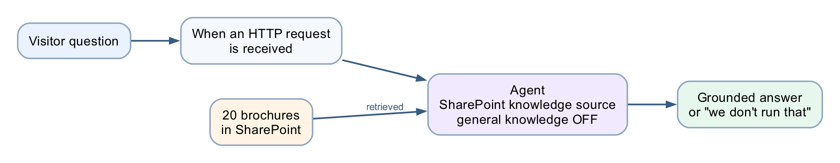
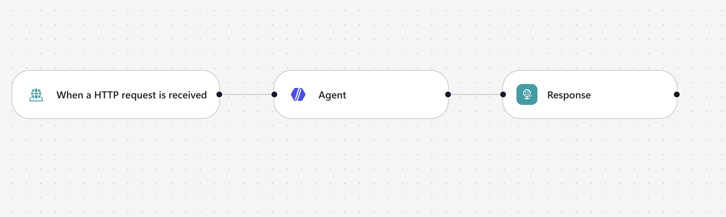
MODULE 5 · LAB WORKFLOW
Lab 9 — RAG with Built-in Knowledge
RAG as a product setting — three nodes, no ingestion, and nothing you can inspect.
LAB 9
Lab 9 — RAG with Knowledge Base
Cook & Bake Academy, built-in knowledge · Copilot Studio Knowledge + SharePoint · 40 min
Business Process Automation with Power Automate & Copilot Studio Agents · TGS-2022017524 · © 2026 Tertiary Infotech Academy Pte Ltd
67

Slide 68
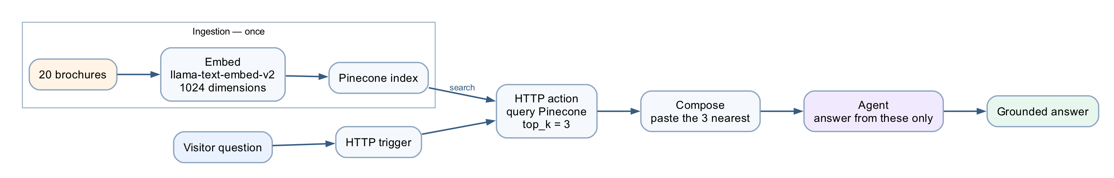
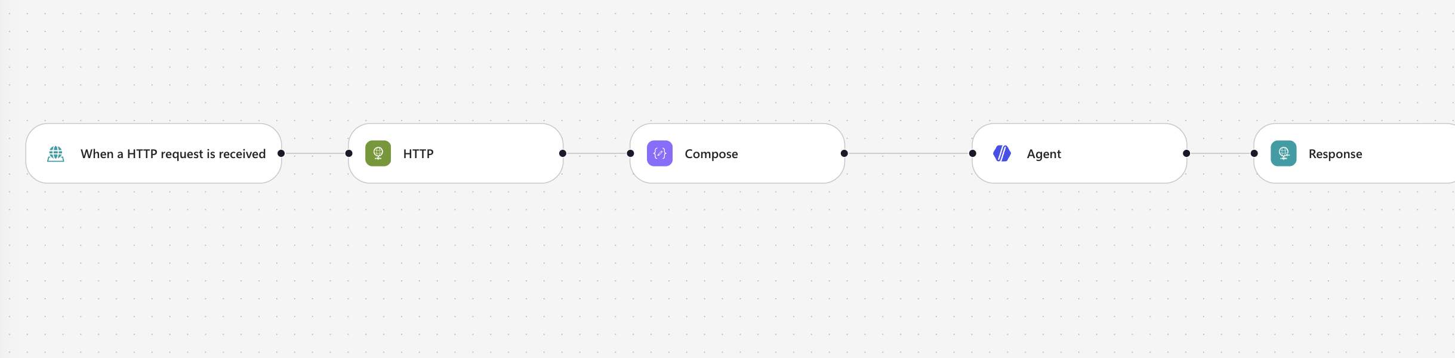
MODULE 5 · LAB WORKFLOW
Lab 10 — RAG with Pinecone
What the convenience cost — chunking, embeddings, dimension and top_k, back in your hands.
LAB 10
Lab 10 — RAG with Pinecone
The same chatbot, with the levers back · Copilot Studio + Power Automate + Pinecone · 40 min
Business Process Automation with Power Automate & Copilot Studio Agents · TGS-2022017524 · © 2026 Tertiary Infotech Academy Pte Ltd
68

Slide 69
SYNTHESIS
Taking This Back to Work
Choosing the pattern · the pre-production checklist · the six sentences worth keeping
Business Process Automation with Power Automate & Copilot Studio Agents · TGS-2022017524 · © 2026 Tertiary Infotech Academy Pte Ltd
69

Slide 70
SYNTHESIS
Choosing the Right Pattern
Back at work, this is the decision you will actually make.
If the situation is…
…build this
Seen in
The rule is written down and never varies
Workflow only
Labs 1–3
The rule varies, but the outcome is high-stakes
Agent decides, flow enforces, human approves
Labs 6, 8
The input is language, the output is an answer
Agent grounded in your documents
Labs 7, 9, 10
Several audiences, different things they may know
Connected agents, one per boundary
Lab 4
The answer must be traceable to a source
RAG, and turn general knowledge off
Labs 9, 10
Ask who pays for the mistake. That answer sizes the agent's authority and places the human.
Business Process Automation with Power Automate & Copilot Studio Agents · TGS-2022017524 · © 2026 Tertiary Infotech Academy Pte Ltd
70

Slide 71
SYNTHESIS
Before Anything Reaches Production
1
Environment
2
Data path
3
Refusals tested
Correct environment selected in BOTH products; Copilot Credits confirmed.
No model output writes to a system of record without a deterministic action in between.
Every prohibition has a probe that tries to break it, and the probe is in the test set.
4
Human placed
5
Audit before the gate
6
Sources closed
Consequential paths end at a named person, not at a queue nobody watches.
The audit row is written before the approval, so rejected cases still leave a trace.
General knowledge off, "Search all websites" removed, knowledge status Ready.
A green run is not a correct run, and a fluent answer is not a true one. Verify both before anyone depends on it.
Business Process Automation with Power Automate & Copilot Studio Agents · TGS-2022017524 · © 2026 Tertiary Infotech Academy Pte Ltd
71

Slide 72
SYNTHESIS
Six Sentences Worth Keeping
1
A control the model cannot reach beats a rule you asked it to follow.
2
A reference to nothing resolves to empty, not to an error.
3
Commit the record of the obligation before you create the obligation.
4
The AI decides what to do; deterministic actions do what must always happen.
5
A pause that will still be paused tomorrow is a real gate.
6
Retrieval decides whether generation can possibly be right.
Six sentences. If you keep only these, you can rebuild the judgement behind every lab in this course.
Business Process Automation with Power Automate & Copilot Studio Agents · TGS-2022017524 · © 2026 Tertiary Infotech Academy Pte Ltd
72

Slide 73
BEFORE THE ASSESSMENT
Briefing for Assessment
• Place phones and other materials under the table or on the floor.
• No photos or recording of assessment scripts.
• No discussion during the assessment.
• Use a black/blue pen for hard-copy assessments.
• No liquid paper / correction tape.
• Scripts are collected when time is up.
Business Process Automation with Power Automate & Copilot Studio Agents · TGS-2022017524 · © 2026 Tertiary Infotech Academy Pte Ltd
73

Slide 74
FINAL ASSESSMENT
Assessment & Funding
1
Written
2
Practical
3
Evidence
1 hour · open book Modules 1–5 and the lab concepts
1 hour · open book Build and verify a working flow and agent
Submit on the LMS Competent result + attendance requirement
Business Process Automation with Power Automate & Copilot Studio Agents · TGS-2022017524 · © 2026 Tertiary Infotech Academy Pte Ltd
74

Slide 75
ON ASSESSMENT DAY
Assessment Flow
1
2
3
4
5
▶
▶
▶
▶
TRAQOM survey — scan the QR code on the LMS
Assessment digital attendance — scan the SSG QR
Sit WA (SAQ) then PP — open book
Submit your answers on the LMS
Sign the Assessment Summary Record
Business Process Automation with Power Automate & Copilot Studio Agents · TGS-2022017524 · © 2026 Tertiary Infotech Academy Pte Ltd
75

Slide 76
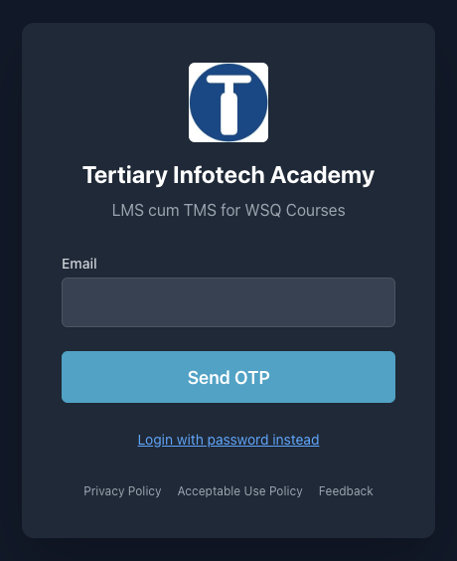
COURSE PORTAL
Courseware & Assessment on the LMS
1 · Sign in
2 · Download materials
lms-tms.tertiaryinfotech.com — log in with your registered email (OTP or password).
Slides and the Learner Guide from the course page — your open-book references.
3 · Submit answers
4 · TRAQOM survey
Upload your Written Assessment and Practical Performance answers on the LMS.
Complete the TRAQOM survey via the QR code shown on the LMS.
https://lms-tms.tertiaryinfotech.com/
Business Process Automation with Power Automate & Copilot Studio Agents · TGS-2022017524 · © 2026 Tertiary Infotech Academy Pte Ltd
76

Slide 77
FINAL ASSESSMENT
Assessment
• Written Assessment (SAQ) — 1 hour. Practical Performance (PP) — 1 hour.
• Open book: slides, Learner Guide and approved materials only.
• Remember to take the Assessment digital attendance (TRAQOM).
• Submit your completed answers on the LMS at https://lms-tms.tertiaryinfotech.com/.
Business Process Automation with Power Automate & Copilot Studio Agents · TGS-2022017524 · © 2026 Tertiary Infotech Academy Pte Ltd
77

Slide 78
ON ASSESSMENT DAY
Assessment Flow
1
2
3
4
5
▶
▶
▶
▶
TRAQOM survey — scan the QR code on the LMS
Assessment digital attendance — scan the SSG QR
Sit WA (SAQ) then PP — open book
Submit your answers on the LMS
Sign the Assessment Summary Record
Business Process Automation with Power Automate & Copilot Studio Agents · TGS-2022017524 · © 2026 Tertiary Infotech Academy Pte Ltd
78

Slide 79
TRAQOM · SSG DIGITAL ATTENDANCE
Digital Attendance (Mandatory)
• It is mandatory to take the AM, PM and Assessment digital attendance for WSQ-funded courses.
• The trainer/administrator displays the digital attendance QR code from the SSG portal.
• Scan the QR code with your mobile phone camera and submit your attendance.
• A minimum of 75% attendance is required to be eligible for assessment and funding.
Business Process Automation with Power Automate & Copilot Studio Agents · TGS-2022017524 · © 2026 Tertiary Infotech Academy Pte Ltd
79

Slide 80
Thank You
Now go automate something — questions welcome
Business Process Automation with Power Automate & Copilot Studio Agents · TGS-2022017524 · © 2026 Tertiary Infotech Academy Pte Ltd
80

